Slide 1
SwimTrain
Exploring Exergame Design for Group Fitness Swimming
Woohyeok Choi KAIST, South Korea
Jeungmin Oh KAIST, South Korea
Darren Edge Microsoft Research Asia, China
Joohyun Kim KAIST, South Korea
Uichin Lee KAIST, South Korea
Notes:
Thanks Chair for introducing me. As he said, I’m Woohyeok Choi, Ph.D student in KAIST,
I’m very glad to be get an opportunity to present my work.
Today, I’m gonna present the paper, ‘SwimTrain: Exploring Exergame Design for Group Fitness Swimming.’
Hopefully, you’ll enjoy my presentation and give valuable feedback to me.
Then, let me start.

Slide 2
Exercise Together
Notes:
As you know, exercise with others is obviously better than exercise lonely in various respects, including motivation and enjoyment. People prefer walking, jogging, or riding bicycles with their friends to doing those activities lonely. Also, I, you, many other researchers, and even industries in this field have employed social aspects to enrich conventional solitary exercise.

Slide 3
Sharing / comparing
exercise records
[Nike+]
Exercise Together
Notes:
A typical approach is to allow people to share their exercise records with others, like Nike+.

Slide 4
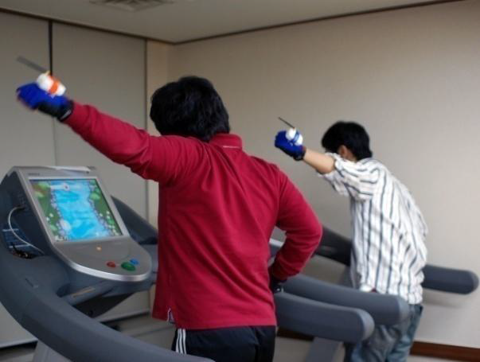
Sharing / comparing
exercise records
Playing video games using their own bodies
[Nike+]
[Ahn, ACE ‘09]
Exercise Together
Notes:
Also, some researchers have attempted to allow players to play video games using their own bodies, not game controllers, such as SwanBoat project.

Slide 5
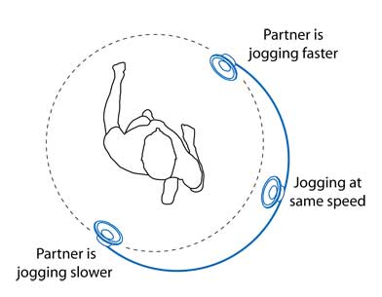
Sharing / comparing
exercise records
Playing video games using their own bodies
Synchronously exercise with others via network
[Nike+]
[Ahn, ACE ‘09]
[Mueller, UIST ‘10]
Exercise Together
Notes:
Another approach is to allow people to synchronously exercise with others via network, such as Jogging over a Distance.

Slide 6
Group Fitness
Fitness exercise performed by a group of people led by an instructor
Notes:
Group fitness is the one of the most well-known forms of exercise together. If you go to a nearby fitness center, you can see that a number of people take a certain exercise together, like yoga, spinning, and aerobics. That is called group fitness or group exercise.
(click)
In definition, group fitness is a form of exercise which are performed by a group of people who are led by an instructor. This motivates people to exercise more, as in exercise together. Also, an instructor encourages people to adhere a training program and helps to develop overall fitness levels.

Slide 7
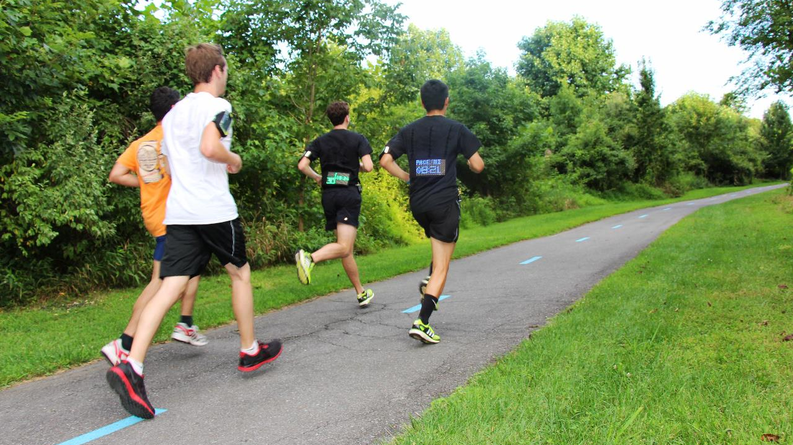
Group Fitness
with Technology
[Mauriello, CHI ‘14]
Notes:
As HCI researchers have enriched conventional exercise in a variety of ways, group fitness can also employ interactive computing to improve exercise experiences. For example, we can put additional interaction opportunities into existing group fitness scenarios, as in Social Fabric Fitness. Or, we can allow remote people to participate group fitness programs and perform synchronized physical activity among them.

Slide 8
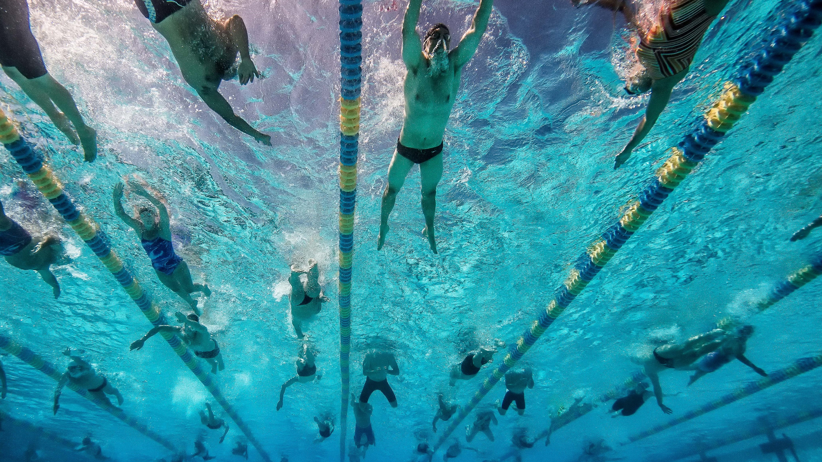
Group Fitness Swimming
Fitness swimming performed by a group of people led by an instructor
Notes:
In this paper, we focus on group fitness swimming, which is fitness swimming performed by a group of people led by an instructor

Slide 9
Small DoF
for interactions
Constraints of Swimming
Notes:
Group fitness swimming is very challenging case to deal with. Because swimming requires a high level of coordinated body movements, it allows only a small degree of freedom for interactions and limited sensory capability.

Slide 10
Small DoF
for interactions
Limited opportunities
for communication
Constraints of Swimming
Notes:
Also, while swimming, people have limited opportunities for verbal communication with others.

Slide 11
Small DoF
for interactions
Limited opportunities
for communication
Vulnerable
network connectivity
Constraints of Swimming
Notes:
As one of technical constraints, it is also difficult to deal with vulnerability of wireless network due to periodic water submersions while swimming.

Slide 12
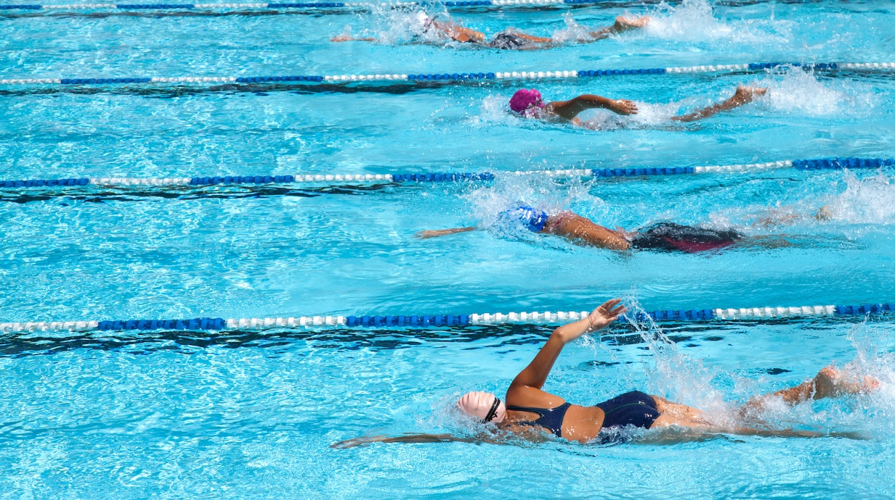
Design Goal
Building group fitness swimming game
providing the similar degree of social experiences as in group fitness without causing information load
Notes:
Considering those constraints, we aim to build group fitness swimming game providing similar social experiences as in instructor-led group fitness without causing information load.

Slide 13
Design Goal
Notes:
Specifically, we should carefully consider cognitive capability. To provide social awareness as in group fitness, we may deliver social awareness from every other swimmers to each individual;
(click)
however, a swimmer cannot process these all awareness information and may suffer from cognitive load. Taking practical constraints on human cognition into account, we design SwimTrain, like this video

Slide 15
Design Process
Expert Interviews
/ Observation
Ideation
/ Prototyping
Pilot Study
/ Design Revision
User Study
Notes:
To this end, we took these steps.

Slide 16
Design Process
Expert Interviews
/ Observation
Ideation
/ Prototyping
Pilot Study
/ Design Revision
User Study
Notes:
(skip)

Slide 17
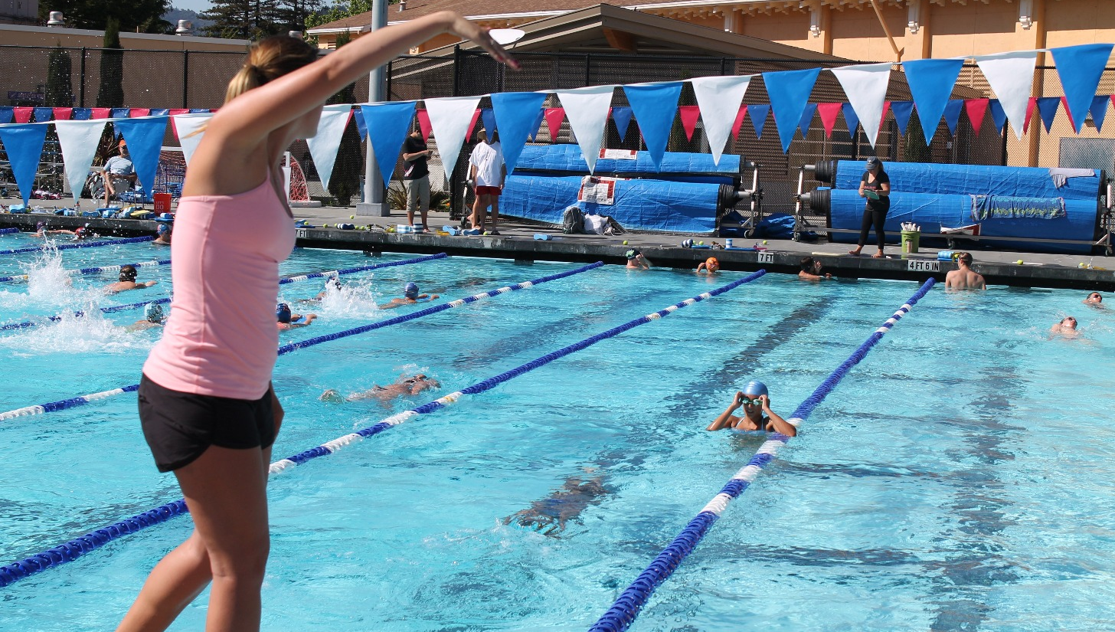
Understanding
Group Fitness Swimming
conducting interviews with swimming instructors (n=3)
/ observing group swimming situations
Notes:
First, to better understand group fitness swimming, we conducted interviews with three swimming instructors, and observed situations of group fitness swimming. From thematic analysis on interview results and observation, we found several characteristics of group fitness swimming.

Slide 18
Lane sharing
“In the case of a class for elementary school students, two lanes were assigned with more than fifteen people. [...] For (adult) workers, one lane was assigned with about ten people.”- E1
Notes:
First, a lane in a swimming pool is often shared by multiple swimmers.

Slide 19
Social norms of the pool
avoid touching one another ’ s bodies (regarded as a taboo) and disrupting others’ training regimens
Similar pace in the same lane
“I allows skilled swimmers to swim in the deeper lane.”- E1
“If I follow up the swimmer ahead and swim faster, the followed
swimmer tells me to go first.”- E2
Notes:
This lane sharing situation forces people who share the lane swim at the similar pace. Swimmers tend to select a lane commensurate with their skill levels, or an instructor assigns a lane to each swimmer according to their swimming skills. If someone swims slower, other swimmers who follow him or her also should slow down. To prevent this, slow swimmers give way to allow the faster swimmers to overtake.
(click)
Such a situation is known to be stemmed from social norms of the pool, tendency to avoid touching others’ bodies and disrupting others’ training regimens.

Slide 20
Congestion in a lane
“When too many people swim in a single lane, they can collide with others [...] The main reason for congestion is swimming skill differences among attendees”– E3
Notes:
If swimmers who share a same lane have different swimming competence, the traffic in the lane is often congested. A swimmer may collide with others, or stop and wait for the swimmer ahead of him or her to create enough buffer space.

Slide 21
Instructor support
“I have different programs according to swimming competence.”– E3
“I give them feedback about when they should breath over as I follow them. Also, I sometimes measure lap time.”- E2
Notes:
Instructors play a important role in group fitness swimming. As I mentioned, they sometimes deal with congested lane traffic. In addition, they provide teaching directions and programs suitable for swimmers’ skill levels. They correct postures and breathing timing, measure the swimming performance, and even, motivate swimmers in a variety of ways.

Slide 22
Design Process
Expert Interviews
/ Observation
Ideation
/ Prototyping
Pilot Study
/ Design Revision
User Study
Notes:
Based on our initial study on group fitness swimming, we ideate our game design.

Slide 23
Train Metaphor
Real Space
Virtual Space
Notes:
Especially, we represent the characteristics of group fitness swimming in the game by using a train metaphor.
In this metaphor, a swimmer in the real space is mapped into a compartment of a train in the virtual space.

Slide 24
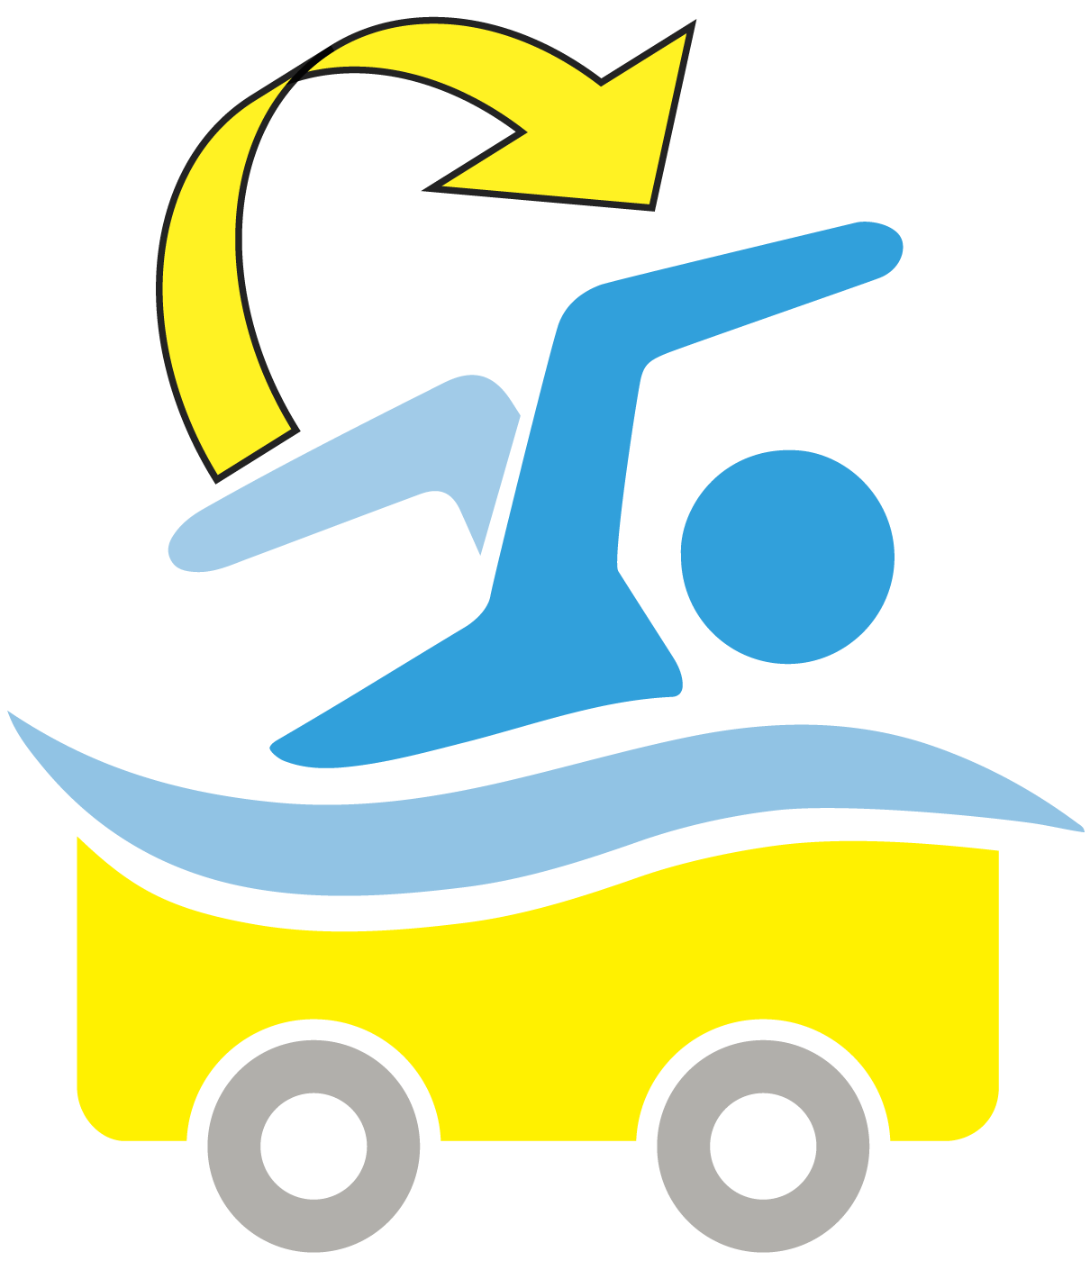
Train Metaphor
Notes:
Each swimmer plays a role of maneuvering his or her corresponding compartment using stroke rates.
(click)
Also, this metaphor naturally transforms a swimming lane into a virtual train track.
(click)

Slide 25
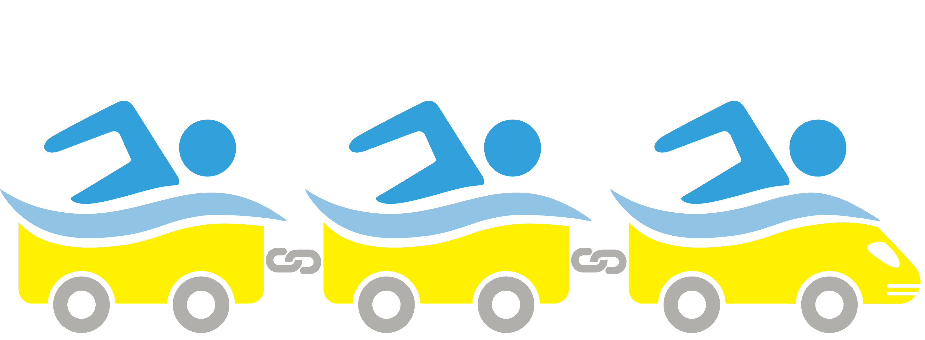
Train Metaphor
Notes:
Compartment along the same track should run at the same speed and maintain a certain distance between them to avoid collision, as in group fitness swimming.

Slide 26
Train Metaphor
Alice is behind you!
Notes:
In addition, we allow an in-game narrator to play a similar role as an instructor of group fitness swimming. For example, it informs of game rules and provides feedback about swimming performance, as explained later.

Slide 27
Game Flow
Competitive phase
$$Y_{t}= αX_{t}+(1−α)Y_{t−1}$$
Compartment Ordering
$X_{t}$: stroke rate at time $t$
Establishing a target stroke rate
with train cars racing
$Y_{t}$: accumulated stroke rate at time $t$
Single Round
Notes:
SwimTrain consists of multiple rounds and each round is divided into three phases.
First, Compartment Ordering phase is a sort of competition. In this phase, each swimmer’s stroke rate is measured and accumulated using weighted moving average scheme. We called this accumulated stroke rate the target stroke rate.

Slide 28
Game Flow
Competitive phase
Compartment Ordering
Establishing a target stroke rate
with train cars racing
Single Round
Notes:
Compartments races against other compartments using target stroke rate, and swimmers are awarded points according to the final order of the compartments. Whenever swimmers perform a stroke, they are indirectly informed of their current rankings in respects of changes of order of their immediately adjacent compartments, like this.

Slide 29
Game Flow
Competitive phase
Compartment Ordering
Establishing a target stroke rate
with train cars racing
Cooperative phase
Train Running
Single Round
Too Slow | Slow | Match | Fast | Too Fast
Maintaining a target stroke rate
with pseudo-cooperation
Notes:
Next phase is cooperative phase, called Train Running. The goal of this phase is to maintain a target stroke rate as long as possible. Whenever swimmers performs a stroke, their stroke rates are compared with the target stroke rate, and a system gives points depending on how well they matched their stroke rate with the target stroke rate.

Slide 30
Game Flow
Competitive phase
Compartment Ordering
Establishing a target stroke rate
with train cars racing
Cooperative phase
Train Running
Single Round
Maintaining a target stroke rate
with pseudo-cooperation
Notes:
A compartment shifts forward and backward with the current stroke rate relative to the target stroke rate. For example, when the given stroke rate is higher than the targer stroke rate, a compartment moves forward. Also, if the current stroke rate is much higher and lower than the target stroke rate, their compartment collides against adjacent compartments, like this.

Slide 31
Game Flow
Competitive phase
Compartment Ordering
Establishing a target stroke rate
with train cars racing
Cooperative phase
Train Running
Single Round
Maintaining a target stroke rate
with pseudo-cooperation
Break phase
Train Stop
Taking a short break
/ informing of rankings and next round
Notes:
In the last phase, Train Stop, a virtual train stops and every players take a short break. During this phase, an in-game narrator informs of rankings in this round, and gives information regarding the next round, such as durations of each phase.

Slide 32
Peephole Interaction Design
Notes:
When providing social awareness, we should consider cognitive capability for processing given information. If we provide too much information, players may suffer from information overload. And if not, they may feel insufficient social awareness. To handle this issue, we employ Peephole design concept.

Slide 33
Providing a limited view of a larger information space
Peephole Interaction Design
Notes:
Peephole concept is defined as providing a limited view of a larger information space.

Slide 34
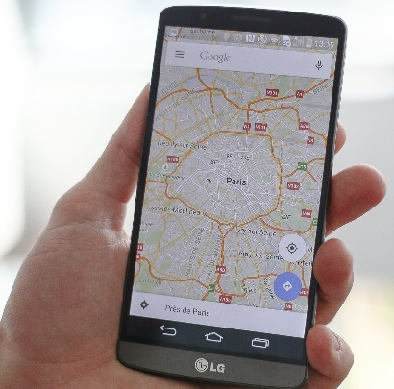
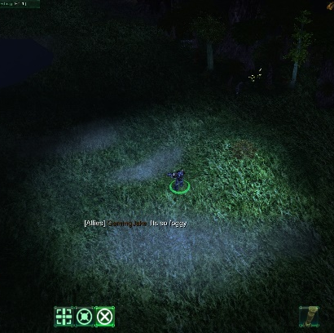
Navigating large info. spaces in hand-held devices with small displays
Fog-of-war system
in video games
Providing a limited view of a larger information space
Peephole Interaction Design
Notes:
For example, when we navigate a large map using a smartphone, the smartphone shows a limited area of the map. Also, many video games have utilized peephole concept as fog-of-war system to build suspense.

Slide 35
Subgrouping and interacting with
virtually ahead and behind players
Bob is behind you!
Peephole Interaction Design
Notes:
In SwimTrain, each player is subgrouped with only virtually adjacent players, namely ahead- and behind-player. Also, we allows each player only to interact with adjacent players. Therefore, players only need to concern themselves with the movement of their own bodies and adjacent compartments.

Slide 36
Pseudo-cooperation: Providing the illusion of cooperation, instead of supporting actual synchrony
Peephole Interaction Design
Notes:
In addition to this, in a view of each compartment, adjacent compartments do not move and remain fixed. The distance to each adjacent compartment is determined by each player’s stroke rate, regardless of the others’ stroke rates. Thus, SwimTrain does not support actual synchronous cooperation among players, rather offers the illusion of cooperation. That is why we called pseudo-cooperation.
By doing this, we can reduce unpredictability and complexity of cooperative movements, so that each player only needs to match his or her stroke rates with the target stroke rate.

Slide 37
Chaining subgroups and
organizing whole players into a single group
Peephole Interaction Design
Notes:
Each behind-mid-ahead triplet forms one subgroup, and we chain each subgroup to organize whole players into a large single group.

Slide 38
Other Design Rationales
Virtual instructor
Intuitive
interactions
Motivating with competition & collaboration
Balanced exertion
Strategic game play
Notes:
What’s more, we consider several design rationales based on exergame guidelines proposed by literature, but in view of time, I shall skip this. For more information, please read our paper.

Slide 39
Server
Network
Manager
Waterproof
earphones
Feedback
Manager
Game
Handler
BGM
Vibro.
Earcon
Narration
Stroke Rate
Waterproof
smartphone
Barometer
Stroke Timing Detector
Prototyping
Swimming stroke
Notes:
After initial ideation, we prototyped SwimTrain. To recognize stroke rate and operate the game, we utilized a waterproof smartphone, which is secured on a swimmer’s upper arm. and auditory feedback is delivered through waterproof earphones.

Slide 40
Server
Network
Manager
Waterproof
earphones
Feedback
Manager
Game
Handler
BGM
Vibro.
Earcon
Narration
Stroke Rate
Waterproof
smartphone
Barometer
Stroke Timing Detector
Prototyping
Swimming stroke
Notes:
Whenever a swimmer perform a stroke, consecutive barometer signals are processed in order to detect stroke timing, as you see in this figure. Stroke rate can be defined as the reciprocal of the interval between two consecutive stroke points. Detected stroke rate is delivered the main game logic, which controls overall operations of SwimTrain, including feedback delivery and network communication.

Slide 41
Server
Network
Manager
Waterproof
earphones
LTE
Feedback
Manager
Game
Handler
“LTE shows more robust performance than 802.11 and 3G under swimming situations”
[Choi, SenSys ‘14]
BGM
Vibro.
Earcon
Narration
Stroke Rate
Waterproof
smartphone
Barometer
Stroke Timing Detector
Prototyping
Swimming stroke
Notes:
For wireless packet exchange with a remote server, we utilize LTE, which is known as the most robust electromagnetic wireless networking technology under water.

Slide 42
Design Process
Expert Interviews
/ Observation
Ideation
/ Prototyping
Pilot Study
/ Design Revision
User Study
Notes:
After prototpying, we conducted early user study to revise our game design.

Slide 43
Initial Prototype
Informing of rankings
Directly notifying of relative SR
Using a spatial earcon
Not referring to nicknames
Preliminary User Study
Notes:
Before revision, our initial prototype was different in some points.

Slide 44
Initial Prototype
Informing of rankings
Directly notifying of relative SR
Using a spatial earcon
Not referring to nicknames
Every 4 seconds,
“You take 3rd place!”
Preliminary User Study
Notes:
First, it informed of rankings explicitly in number, not the overtake or overtaken information.

Slide 45
Initial Prototype
Informing of rankings
Directly notifying of relative SR
Using a spatial earcon
Not referring to nicknames
Every 4 seconds,
“You are too slow!”
Preliminary User Study
Notes:
Also, it gave direct feedback regarding how players match their current stroke rate with the target stroke rate.

Slide 46
Initial Prototype
Informing of rankings
Directly notifying of relative SR
Using a spatial earcon
Not referring to nicknames
Being heard ahead of a player if they stroked faster than the target SR
Preliminary User Study
Notes:
As proposed in Jogging over a Distance, we tentatively employed a spatial earcon. For example, if a swimmer perform a faster stroke that the target stroke rate, that means a corresponding compartment shift forward, a spatial earcon, like click-clack sound, was heard ahead of the player.

Slide 47
Initial Prototype
Informing of rankings
Directly notifying of relative SR
Using a spatial earcon
Not referring to nicknames
Preliminary User Study
Notes:
And in initial protype, we did not support nickname settings.

Slide 48
Initial Prototype
Informing of rankings
Directly notifying of relative SR
Using a spatial earcon
Not referring to nicknames
Recruiting
4 swimmers
1st Round
(CO: 60s, TR: 60s, TS: 50s)
2nd Round
(CO: 60s, TR: 120s, TS: 80s)
3rd Round
(CO: 40s, TR: 40s, TS: 30s)
4th Round
(CO: 40s, TR: 80s, TS: -)
Group interview
Preliminary User Study
Notes:
Using such an prototype, we conducted user study with four swimmers. All participants began the game at the same time and played four rounds in total. After then, we conducted a group interview for 45-minute.

Slide 49
Initial Prototype
Informing of rankings
Directly notifying of relative SR
Using a spatial earcon
Not referring to nicknames
Revision
Adding ambiguity in rankings
and relative SR
Not using a spatial earcon
Allowing to set nicknames
Adjusting phase duration
Recruiting
4 swimmers
1st Round
(CO: 60s, TR: 60s, TS: 50s)
2nd Round
(CO: 60s, TR: 120s, TS: 80s)
3rd Round
(CO: 40s, TR: 40s, TS: 30s)
4th Round
(CO: 40s, TR: 80s, TS: -)
Group interview
Preliminary User Study
Notes:
Based on interview results, we revised the prototype.

Slide 50
“You are too fast!”
→“You crash into Alice!”
Revision
Adding ambiguity in rankings
and relative SR
Not using a spatial earcon
Allowing to set nicknames
Adjusting phase duration
Recruiting
4 swimmers
1st Round
(CO: 60s, TR: 60s, TS: 50s)
2nd Round
(CO: 60s, TR: 120s, TS: 80s)
3rd Round
(CO: 40s, TR: 40s, TS: 30s)
4th Round
(CO: 40s, TR: 80s, TS: -)
Group interview
Preliminary User Study
Notes:
First, informing of rankings in number directly brought about too much competitive aspect. Also, direct feedback regarding stroke rate match seemed not to be enjoyable. Therefore, we added some ambiguity in rankings and stroke rate match.
For example, in-game narrator tells “you crash into Alice” if a swimmer perform a stroke too fast, unlike “you are too fast!”

Slide 51
“You take 1st place!”
→“You overtook Alice!”
Revision
Adding ambiguity in rankings
and relative SR
Not using a spatial earcon
Allowing to set nicknames
Adjusting phase duration
Recruiting
4 swimmers
1st Round
(CO: 60s, TR: 60s, TS: 50s)
2nd Round
(CO: 60s, TR: 120s, TS: 80s)
3rd Round
(CO: 40s, TR: 40s, TS: 30s)
4th Round
(CO: 40s, TR: 80s, TS: -)
Group interview
Preliminary User Study
Notes:
And not rankings in number, just it tells overtake or overtaken information, like “you overtook Alice”

Slide 52
Revision
Adding ambiguity in rankings
and relative SR
Not using a spatial earcon
Allowing to set nicknames
Adjusting phase duration
Recruiting
4 swimmers
1st Round
(CO: 60s, TR: 60s, TS: 50s)
2nd Round
(CO: 60s, TR: 120s, TS: 80s)
3rd Round
(CO: 40s, TR: 40s, TS: 30s)
4th Round
(CO: 40s, TR: 80s, TS: -)
Group interview
Preliminary User Study
Notes:
Also, all participants could not recognize spatial earcon. It seemed to be due to the limitation of software-only implementation and too limited cognitive capability to realize directions of earcon. Therefore, we eliminated spatialized sound effect.

Slide 53
Revision
Adding ambiguity in rankings
and relative SR
Not using a spatial earcon
Allowing to set nicknames
Adjusting phase duration
Recruiting
4 swimmers
1st Round
(CO: 60s, TR: 60s, TS: 50s)
2nd Round
(CO: 60s, TR: 120s, TS: 80s)
3rd Round
(CO: 40s, TR: 40s, TS: 30s)
4th Round
(CO: 40s, TR: 80s, TS: -)
Group interview
Preliminary User Study
Notes:
Some participants reported that he wanted more information about other players. So, we allow players to set their own nickname, and in-game narrator to tell their nickname when providing auditory feedback.

Slide 54
Revision
Adding ambiguity in rankings
and relative SR
Not using a spatial earcon
Allowing to set nicknames
Adjusting phase duration
Recruiting
4 swimmers
1st Round
(CO: 60s, TR: 60s, TS: 50s)
2nd Round
(CO: 60s, TR: 120s, TS: 80s)
3rd Round
(CO: 40s, TR: 40s, TS: 30s)
4th Round
(CO: 40s, TR: 80s, TS: -)
Group interview
Preliminary User Study
Notes:
Finally, the durations of phases in our initial prototype were not appropriate. The time for a break was relatively too short, and the time for swimming is too long. In the revision, we double the break time.

Slide 55
Design Process
Expert Interviews
/ Observation
Ideation
/ Prototyping
Pilot Study
/ Design Revision
User Study
Notes:
With revised version of SwimTrain, we conducted user study again with eleven participants.

Slide 56
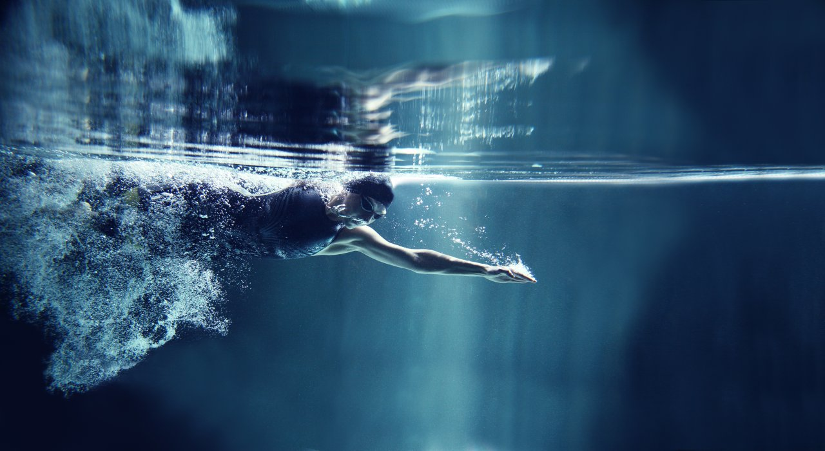
User Study
Recruiting
11 swimmers
6 members
1st Round
(CO: 60s, TR: 60s, TS: 90s)
2nd Round
(CO: 40s, TR: 90s, TS: 120s)
3rd Round
(CO: 60s, TR: 90s, TS: 90s)
4th Round
(CO: 60s, TR: 120s, TS: -)
Group interviews
5 members
Notes:
We divided them into six and five member groups, and each group played four rounds. After completing the game, we conducted group interviews.

Slide 57
User Study
Enriched social experiences during swimming
“Even though each player used a separate lane, it [SwimTrain] felt like swimming in a single lane all together [...] Since it kept announcing the nicknames, it made me wonder who that person was.”- P8
“This game allowed me to feel like I was swimming together with other people, and evoked a friendly feeling, even if I was swimming alone.”- P7
Notes:
From thematic analysis of interview results, we mainly find four topics.
First, our game gives enriched social swimming experiences. Participants reported that they felt like swimming in the same lane together, even if they used separate lanes. Also, they felt somewhat friendship from other players.

Slide 58
User Study
Motivating highly intense workouts
“In this game, a rest time is fixed, and a narrator instructs me to resume swimming. That makes me work out more.”- P6
“I felt the strain when I heard a message like ‘Someone is right behind you.’ So I swam faster.”- P11
Notes:
Also, we found in-game narrator played a role to motivate highly intense workout, as a role of a real instructor. Moreover, our peephole interaction encourage players to swim faster by fosering tensions.

Slide 59
User Study
Confusion due to limited information
“The racing game shows me how close the opponent is. However, this
game [SwimTrain] just notifies me if someone is behind or if someone has overtaken me. I hope it provides information about how close the other swimmers are in more detail.”- P8
Notes:
However, peephole interaction sometimes caused confusion due to the ambiguity and the limited amount of information. Some participants wanted more detalied information about the game progress

Slide 60
User Study
Dealing with differences in skill level
This game allows me to swim at my own pace, and, at the same time, makes me feel as if I am swimming with others”- P8
“It will be fun to play this game with swimmers of matching skill. If not, tension or motivation seems to decrease.”- P1
“I intentionally swam slowly in the CO phase and kept up my pace consistently. So, I ended up winning first place in that round.”- P3
Notes:
In balancing skill differences, participants debated the pros and cons of the appropriate competence of swimmers to play SwimTrain. Two participants commented that SwimTrain can involve swimmers with different skill levels, but other two participants disagreed with that.
Interestingly, some participants overcame different skill levels by strategically setting and maintaining the target pace. They deliberately set low target stroke rate in order to match their current stroke rate with the target stroke rate well.

Slide 61
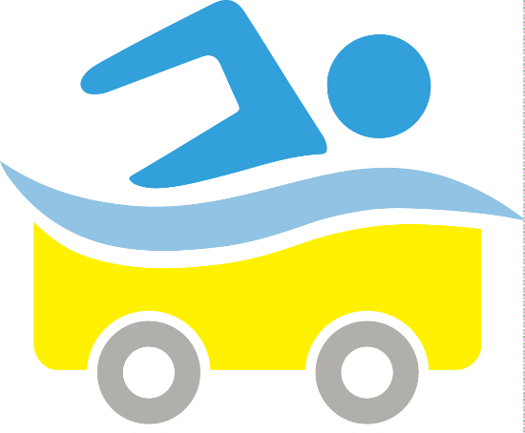
Discussion on
Group Coordination
Main Design Challenge
Gamifying group fitness swimming by coordinating a group of swimmers and yet delivering group awareness without causing information overload
Notes:
From our study, I would like to discuss group coordination issues. As I mentioned, the main design challenge is to build group fitness swimming game by coordinating a group of swimmers and yet delievering group awareness without causing information overload

Slide 62
Discussion on
Group Coordination
Subgroup Formation
Dynamically forming subgroups according to player’s exertion levels in the CO phase of each round
Notes:
For this, we first organize each subgroup with three virtual compartments. This subgroup formation dynamically happens in the CO phase of each round, regarding each player’s swimming skill

Slide 63
Discussion on
Group Coordination
Intra-group Interactions
Coordinating user interactions such
that three players compete against and cooperate with one another
Notes:
In each subgroup, players interact with virtually adjacent players such that compete against and cooperate with one another.

Slide 64
Discussion on
Group Coordination
Inter-group Interactions
Chaining adjacent subgroups to form one large group
Notes:
And these subgroups are chained to form one large group. Also, we provide global awareness, such as overall rankings, only when player do not have to concern their own movements, in other words, when a short break phase.

Slide 65
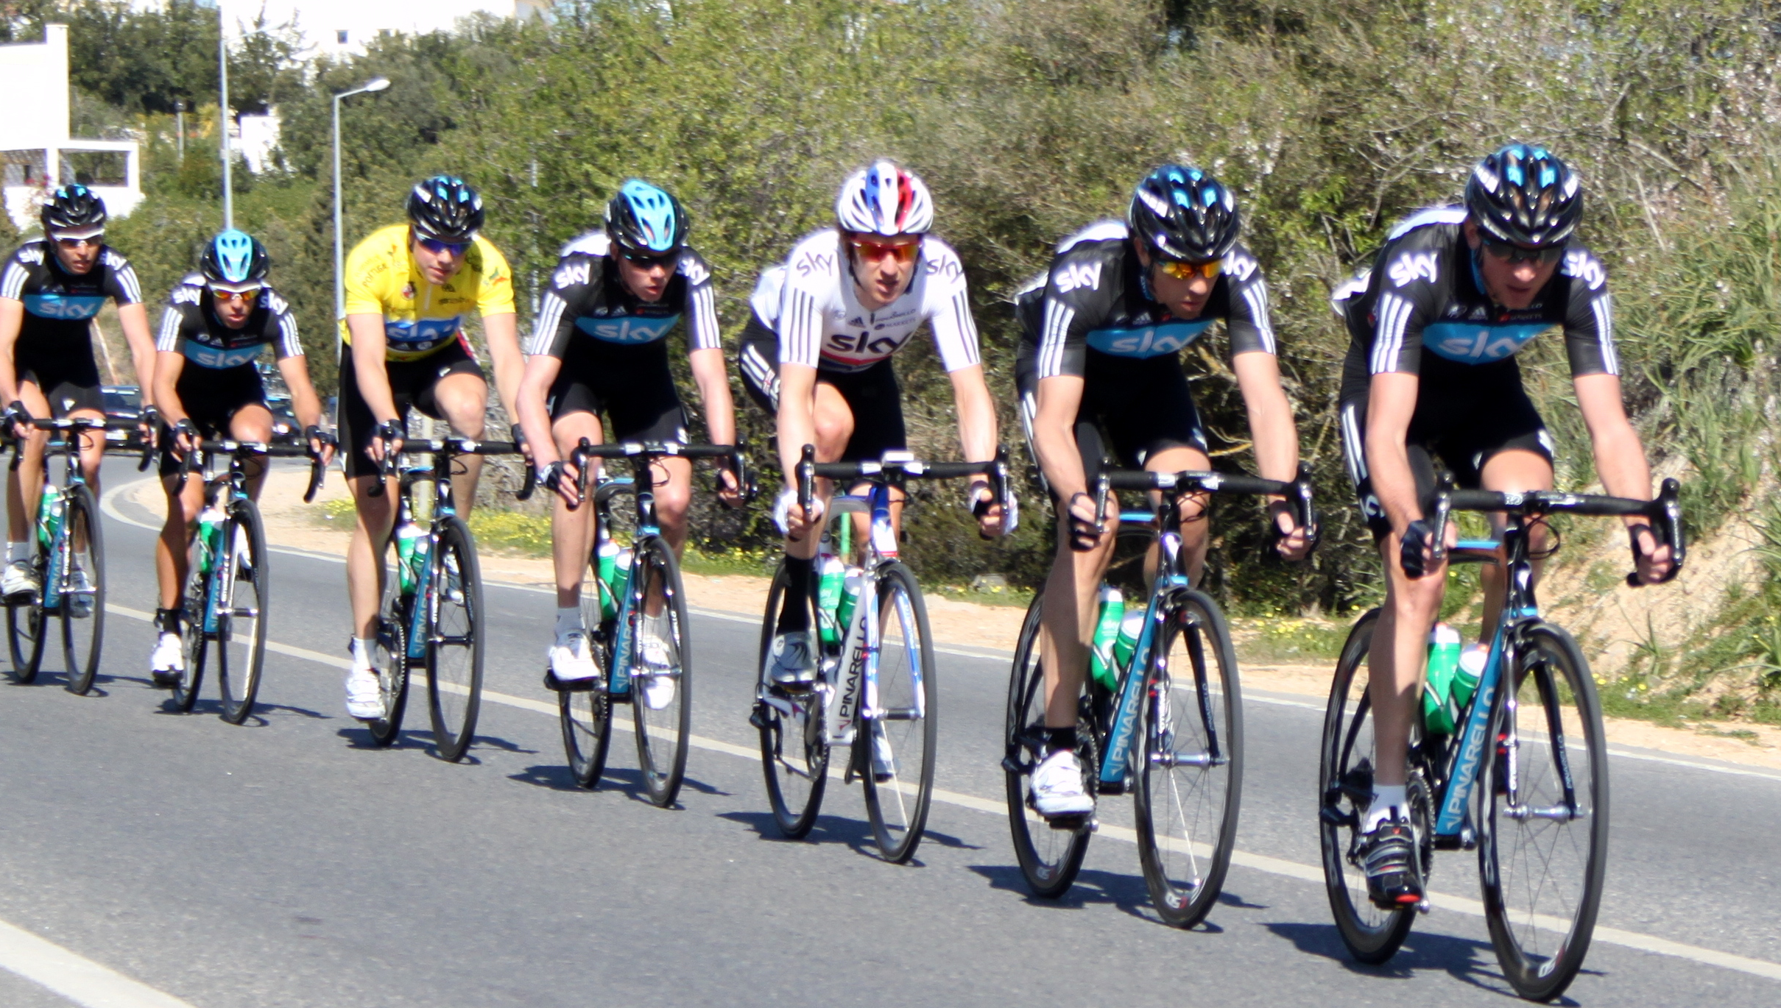
Followers
Leader
Case: Group Fitness Cycle
Notes:
To generalize our findings, we give an example about group cycling. Typically, there is one leader and the other followers in group cycling drill. They keep a paceline, and take turns to be the leader periodically, in order to distribute the physical burden imposed on the leader due to air-resistance.

Slide 66
Subgroup Formation
Subgrouping and interacting with a leader and immediate followers
Case: Group Fitness Cycle
Notes:
For subgroup formation, SwimTrain utilize players’ exertion levels and rearrange them in the CO phase of each round. We can instead use geographically proximity of participants in case of group cycling. For example, a leader can form a subgroup with his/her immediate followers, and these subgroups can be merged or separated according to geographical distance between subgroups.

Slide 67
Intra-group Interactions
Periodically forcing followers
to be a leader within a subgroup
Case: Group Fitness Cycle
Notes:
In intra-group interactions, SwimTrain supports competition and cooperation with adjacent players. Instead of this, in group cycling, we can consider periodically forcing players in a subgroup to be a leader.

Slide 68
Intra-group Interactions
Competition among subgroups,
such as Snake game
Case: Group Fitness Cycle
Notes:
For interactions between subgroups, SwimTrain use subgroup chains and provides global awareness when players do not have to swim. In group cycling, we can employ competitive aspects between subgroups. For example, when one subgroup catch up with another subgroup,

Slide 69
Intra-group Interactions
Competition among subgroups,
such as Snake game
Case: Group Fitness Cycle
Notes:
the subgroup caught is integrated and the larger subgroup can be formed, like classic snake game.
Like this, considering subgroup formation, inter- and intra-group interactions, we can devise new and enjoyable group fitness applications.

Slide 70
Summary
The aim of this work is to build group fitness swimming game providing the similar degree of social experiences as in group fitness without causing information load.
By forming subgroups, limiting a view of interactions to a subgroup, and organizing subgroups to form whole group, SwimTrain deliver enriched group exercise experiences without information overload
Notes:
Now I’m gonna summarize presentation. In this work, we investigate group fitness swimming to design novel exergame which can enrich group fitness exercises.
Carefully considering the situation of group fitness swimming and human cognitive capability, we designed SwimTrain, which allows a group of people to have localized synchronous interactions over a virtual space. We devise novel group coordination methods to deliver enriched social experiences without causing information overload.

